Slide 1
Responding to the call of God to a higher level of spiritual maturity
Hinds feet on high places
03/02/19
Notes:
Recap: Last week, Dino shared about lessons from the Song of Solomon and how he wants to develop love-obedience and how God wants us to not remain where we are but mature. As we mature in Him, we see His heart for others. By learning how He sees us, we can then see others the way He sees us.
One of the books I read when I was a teenager was “Hinds Feet in High Places”. It’s an allegory – story, poem or picture that has a hidden meaning (in this case, spiritual). Like Pilgrims Progress, this book gives us insight into our christian walk / life / journey. The central character is a young woman called Much Afraid who journeys to the High places of the Shepherd. The title of the book is based on Much Afraid’s desire to dance on the high places the way the sure-footed deer do. The Shepherd is delighted in her desire and responds by leading her on this journey. Through the journey Much Afraid grows in spiritual maturity.

Slide 2
Key Scriptures
Ps 18:33
He makes my feet like the feet of deer, And sets me on my high places.
Hab 3:19
The Lord God is my strength; He will make my feet like deer’s feet, And He will make me walk on my high hills.
Notes:
God is calling us to a higher level, a higher plane, a new experience with Him. He wants us to trust His leadership, have confidence in where He is leading us and move out of our comfort zone to where He is.

Slide 3

Key Scriptures
2 Cor 13:14
The grace of the Lord Jesus Christ, and
The love of God, and
The communion of the Holy Spirit
be with you all.
Amen.
Notes:
This verse reveals our interaction with the Triune God. Let’s break this down

Slide 4
1. The Grace of the Lord Jesus Christ
Phil 2: 1-13
Therefore
  if there is any consolation in Christ,
  if any comfort of love,
  if any fellowship of the Spirit,
  if any affection and mercy,
² fulfill my joy by being like-minded,
having the same love,
being of one accord,
of one mind.

Slide 5
1. The Grace of the Lord Jesus Christ
³ Let nothing be done through selfish ambition or conceit,
but in lowliness of mind let each esteem others better than himself.
⁴ Let each of you look out not only for his own interests,
but also for the interests of others.

Slide 6
1. The Grace of the Lord Jesus Christ
⁵ Let this mind be in you which was also in Christ Jesus,
⁶ who, being in the form of God,
did not consider it robbery to be equal with God,
⁷ but made Himself of no reputation,
taking the form of a bondservant, and
coming in the likeness of men.

Slide 7
1. The Grace of the Lord Jesus Christ
⁸ And being found in appearance as a man,
He humbled Himself and
became obedient to the point of death,
even the death of the cross.
⁹ Therefore God also has highly exalted Him and
given Him the name which is above every name,

Slide 8
1. The Grace of the Lord Jesus Christ
¹⁰ that at the name of Jesus every knee should bow,
  of those in heaven, and
  of those on earth, and
  of those under the earth,
¹¹ and that every tongue should confess that Jesus Christ is Lord,
to the glory of God the Father.

Slide 9
1. The Grace of the Lord Jesus Christ
Therefore, my beloved,
as you have always obeyed,
not as in my presence only,
but now much more in my absence,
work out your own salvation with fear and trembling;
¹³ for it is God who works in you both to will and to do for His good pleasure.

Slide 10

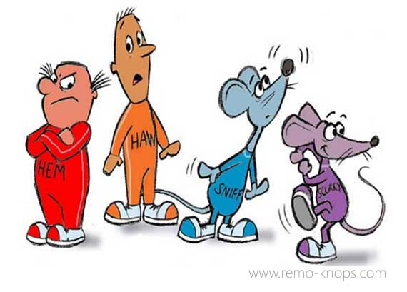
Grace to change and respond to change
Gal 4:19 …Until Christ be formed in you
Notes:
I read another book recently called “Who moved my cheese?” Before you get the wrong idea, I just want to say that I rarely read books these days. The only book I have time for is the bible. But anyway, I promised my colleague that I would read this book and it was a small book anyway. It is absolutely brilliant and I wish for every Christian to read this book. The Book follows four characters – Sniff, Scurry, Hem and Haw. Sniff and Scurry are mice whilst Hem and Haw are two “little people”. They are inside this maze where there are different cheese stations. The story starts off with all four of them at a particular cheese station where the cheese supply is like a mountain. One morning, the cheese was not there at that same cheese station. Sniff and scurry because they had their shoes around their neck ready to go into the great maze had already gone off into the maze to find where the cheese might be. While Hem and Haw remained stuck at the empty cheese station waiting for the cheese to reappear. Days past and finally, Haw bravely goes out into the maze…the great unknown and he learns lessons along the way about responding to change. He writes these lessons down. He discovers that it’s safer to be in the maze (which is the unknown) than to stay at the cheese-less station. He also learns the following lessons
Adapt To Change Quickly
The Quicker You Let Go Of Old Cheese, The Sooner You Can Enjoy New Cheese
Change
Move With The Cheese
Enjoy Change!
Savor The Adventure And Enjoy The Taste Of New Cheese!
Be Ready To Change Quickly And Enjoy It Again
They Keep Moving The Cheese.

Slide 11
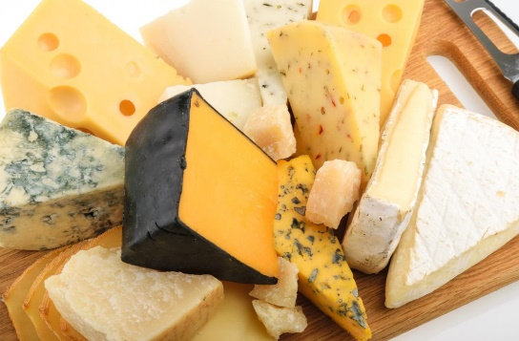
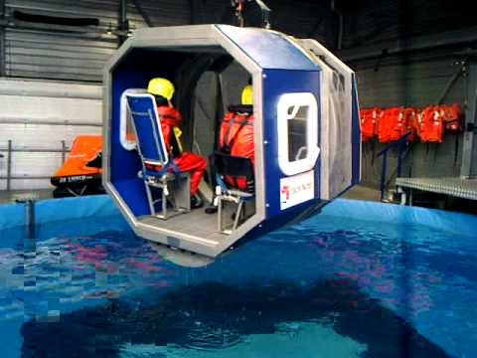
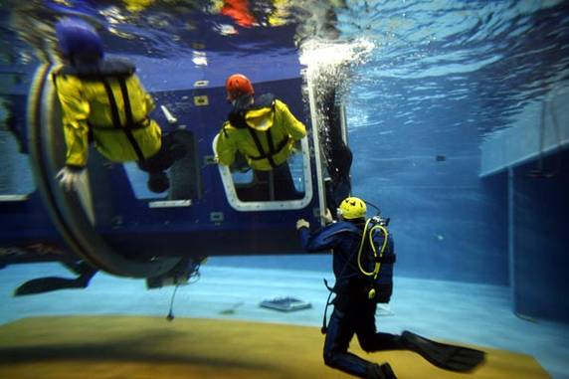
Grace to change
Adapt To Change Quickly
The Quicker You Let Go Of Old Cheese, The Sooner You Can Enjoy New Cheese
Spiritual application:
Let go of old things (ways, thinking) to enjoy fresh things from God (revelation, solutions etc)
Change
Move With The Cheese
Spiritual application:
Move with the Holy Spirit
Enjoy Change!
Savor The Adventure And Enjoy The Taste Of New Cheese!
Spiritual application: Enjoy the process of change and changing
Be Ready To Change Quickly And Enjoy It Again
They Keep Moving The Cheese.
Spiritual application:
Have a mindset of continual growth and change
Notes:
Reading this book and reflecting, it reminded me of points in my life where I had begun to get comfortable. And that when I changed my attitude towards the situation, I was able to grow and enjoy what was on the other side.
2017 was a year of tremendous change for me in my job. I was thrown into a very dynamic Project environment where there weren’t always clear guidance, processes, or defined stuff. I had to deal with constant change on a daily basis.
For example, TBOSIET which is how to survive in tropical waters if you have to abandon a submerged helicopter or a vessel. Just to explain to you the process, you are trapped inside a helicopter shell that is fully submerged in water, the helicopter is upside down because of the weight distribution (if a helicopter crashes on the water, it will turn upside down because the rotars are the heaviest part of the helicopter). You have to hold your breath, undo your safety belt, push open the windows and then make your way out all the while being upside down. Now if you’re not at the window seat, you have to wait for others to go first. That may all sound really easy but when you are underwater and upside down, everything becomes blurry. They dunk you several times. The first time, I panicked and fear set in. I felt fear. I thought I was going to die. I prayed and I asked Holy Spirit to help me. And after that, I became calm. I figured out that when you panic, you can’t hold your breath for as long. Whereas if you stay calm, you become clear headed and you can hold your breath longer. A nose clip also helps by the way. It was only when I changed my attitude towards this situation – I was able to embrace the growth.
Challenging myself to talk about Jesus to my colleagues, praying for them – can be awkward etc.
How does this apply to us? Sometimes we can have the same attitude as Hem and Haw (being indecisive). We can stay in our comfort zone and never challenge ourselves to grow or to allow Christ to be formed inside of us. We take the easy way out.

Slide 12

2. The Love of God
Matt 22:37-39 - Jesus said to him, “‘You shall love the Lord your God with all your heart, with all your soul, and with all your mind.’ This is the first and great commandment. And the second is like it: ‘You shall love
your neighbour as yourself.’
John 15:9-10 - “As the Father loved Me, I also have loved you; abide in My love. If you keep My commandments, you will abide in My love, just as I have kept My Father’s commandments and abide in His love.

Slide 13
A Jealous God
Hos 2:5
For she said,
‘I will go after my lovers,
Who give me
  my bread and
  my water,
  My wool and
  my linen,
  My oil and
  my drink.’
Hos 2:8
For she did not know
That I gave her grain,
  new wine, and
  oil, And multiplied her
  silver and
  gold
Which they prepared for Baal.
Notes:
Where do we look to get our fulfillment, our happiness, our security and sustenance from?
Lovers represent the places we go to to find our our fulfillment, our happiness, our security and sustenance.
They could be our family members, our spouses, our jobs and careers, friends…
The Lord says, I am the One who gives all that to you. I even multiplied it.

Slide 14
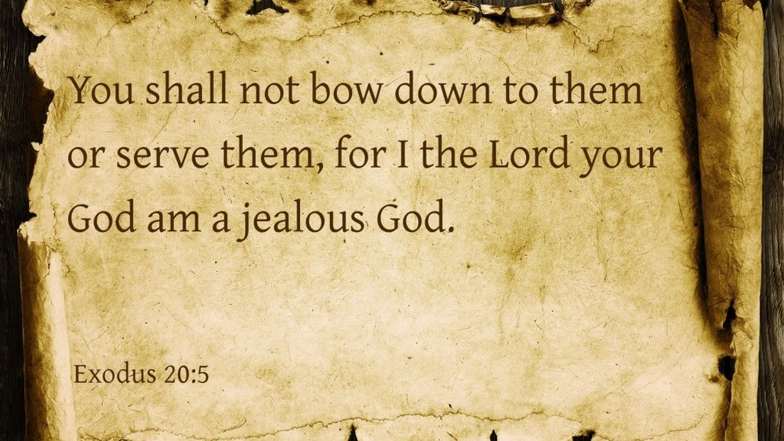
A Jealous God
Hos 2:13 “…She decked herself with her earrings and jewelry and went after her lovers; But me she forgot,” says the Lord.
Phil 2:21 For all seek their own, not the things which are of Jesus Christ.
Notes:
We treat God as if He doesn’t want to be a part of our lives, as if it’s somehow inconvenient – so we make our own plans (retirement plans, holiday plans, career plans, we don’t to ask God what He thinks when we make decisions).
Story of my life – HR. I had a plan for a career. I didn’t want to work at an oil and gas company. That was the LAST PLACE on earth that I wanted to work. They are greedy, they are irresponsible, they are evil. But over a period of 6 months, God changed my attitudes and my perspective and I began to see that actually this is the place where God wanted me.
I have met so many people at work that I have either shared with, prayed with or given a tract to. Just recently, I bumped into a man that I used to work with four years ago. He came up to me and he said, I still remember what you said to me. I had prayed for him at one of his lowest points when his marriage and family was crumbling and the pressure and negative experiences he was having at work impacted him. I also gave him a copy of the Courageous DVD to encourage him. We have no idea how God wants to use us where we are. Or the plans that He has for us because we are too busy making our own plans.

Slide 15

A Loving God – the call to come to Him
Despite playing the harlot, He calls us to Himself
Hos 2:16 “And it shall be in that day says the Lord, “That you will call me ‘My Husband’, and no longer call Me ‘My Master’”
Hos 2:19 “I will betroth you to me forever – Yes, I will betrothe you to me
In righteousness and
justice,
In loving-kindness and
mercy
Hos 2:23 “Then I will say to those who were not My people, ‘You are my people!’ And they shall say ‘You are my God!’
Hos 6:1-3 “Come let us return to the Lord….Let us know, Let us pursue…”

Slide 16
3. Communion of the Holy Spirit
Helps us to understand God’s emotions –
  How does He view each matter?
  How does He feel about us?
  How does He feel about what we are doing?
  How does He feel about what is happening in our lives?
Helps us to receive the grace and love

Slide 17
Conclusion
The Grace of the Lord Jesus Christ is released for us to be changed – the He might be fully formed in us
The Love of God is calling us into a deeper relationship with Him – He is jealous over us!
The Communion of the Holy Spirit enables us to receive the grace and love
Notes:
Trust His leadership
Let Him take us higher
Let us respond to His call to go up the mountain

